Slide 1
IBM Bluemix
And JazzHub

Slide 2

Are you ready to develop in the cloud?

Slide 3
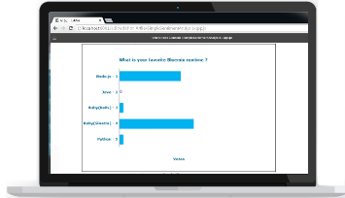




We have an app that displays survey results as they come in.
It’s running in the Bluemix Cloud.
We need you to write an app that submits survey responses

Slide 4
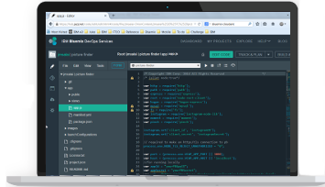





You just need your laptop browser.
IDE
JazzHub, also in the Cloud, gives you all the tools to develop and maintain code.
Build
Develop
Built Artifacts
Deliver
Request Build
SCM

Slide 5
Deploy your code. JazzHub to Bluemix.
IDE
Build
Develop
Built Artifacts
Deliver
Request Build
SCM

Slide 6

Let’s build an app!

